Slide 1
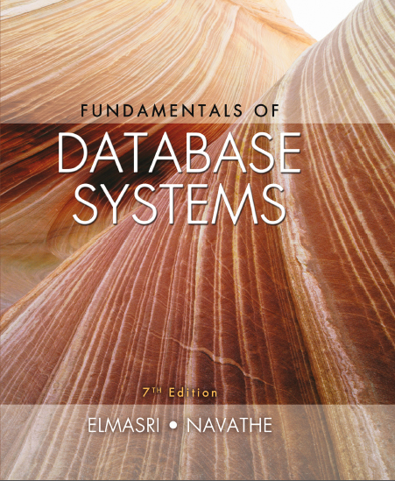
Fundamentals of Database Systems
Seventh Edition
Chapter 1
Databases and Database Users
Copyright © 2016, 2011, 2007 Pearson Education, Inc. All Rights Reserved
Notes:
If this PowerPoint presentation contains mathematical equations, you may need to check that your computer has the following installed:
1) MathType Plugin
2) Math Player (free versions available)
3) NVDA Reader (free versions available)

Slide 2
Learning Objectives
1.1 Types of Databases and Database Applications
1.2 Basic Definitions
1.3 Typical D B M S Functionality
1.4 Example of a Database (University)
1.5 Main Characteristics of the Database Approach
1.6 Types of Database Users
1.7 Advantages of Using the Database Approach
1.8 Historical Development of Database Technology
1.9 Extending Database Capabilities
1.10 When Not to Use Databases

Slide 3
Types of Databases and Database Applications
Traditional Applications:
Numeric and Textual Databases
More Recent Applications:
Multimedia Databases
Geographic Information Systems (G I S)
Biological and Genome Databases
Data Warehouses
Mobile databases
Real-time and Active Databases
First part of book focuses on traditional applications
A number of recent applications are described later in the book (for example, Chapters 24,25,26,27,28,29)

Slide 4
Recent Developments (1 of 2)
Social Networks started capturing a lot of information about people and about communications among people-posts, tweets, photos, videos in systems such as:
Facebook
Twitter
Linked-In
All of the above constitutes data
Search Engines- Google, Bing, Yahoo : collect their own repository of web pages for searching purposes

Slide 5
Recent Developments (2 of 2)
New Technologies are emerging from the so-called non-database software vendors to manage vast amounts of data generated on the web:
Big Data storage systems involving large clusters of distributed computers (Chapter 25)
N O S Q L (Not Only S Q L) systems (Chapter 24)
A large amount of data now resides on the “cloud” which means it is in huge data centers using thousands of machines.

Slide 6
Basic Definitions
Database:
A collection of related data.
Data:
Known facts that can be recorded and have an implicit meaning.
Mini-world:
Some part of the real world about which data is stored in a database. For example, student grades and transcripts at a university.
Database Management System (D B M S):
A software package/ system to facilitate the creation and maintenance of a computerized database.
Database System:
The D B M S software together with the data itself. Sometimes, the applications are also included.

Slide 7
Impact of Databases and Database Technology
Businesses: Banking, Insurance, Retail, Transportation, Healthcare, Manufacturing
Service Industries: Financial, Real-estate, Legal, Electronic Commerce, Small businesses
Education: Resources for content and Delivery
More recently: Social Networks, Environmental and Scientific Applications, Medicine and Genetics
Personalized Applications: based on smart mobile devices

Slide 8
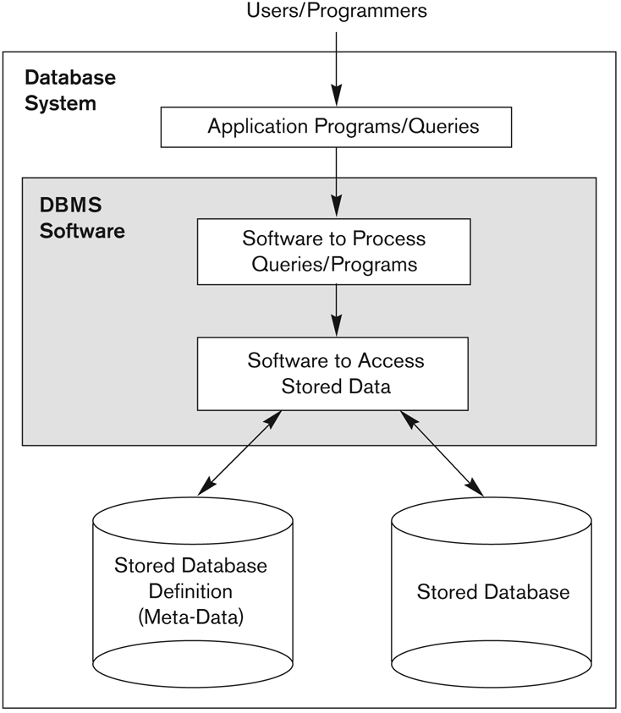
Figure 1.1 Simplified database system environment

Slide 9
Typical D B M S Functionality
Define a particular database in terms of its data types, structures, and constraints
Construct or Load the initial database contents on a secondary storage medium
Manipulating the database:
Retrieval: Querying, generating reports
Modification: Insertions, deletions and updates to its content
Accessing the database through Web applications
Processing and Sharing by a set of concurrent users and application programs – yet, keeping all data valid and consistent

Slide 10
Application Activities Against a Database
Applications interact with a database by generating
Queries: that access different parts of data and formulate the result of a request
Transactions: that may read some data and “update” certain values or generate new data and store that in the database
Applications must not allow unauthorized users to access data
Applications must keep up with changing user requirements against the database

Slide 11
Additional D B M S Functionality
D B M S may additionally provide:
Protection or Security measures to prevent unauthorized access
“Active” processing to take internal actions on data
Presentation and Visualization of data
Maintenance of the database and associated programs over the lifetime of the database application
Called database, software, and system maintenance

Slide 12
Example of a Database (with a Conceptual Data Model) (1 of 2)
Mini-world for the example:
Part of a UNIVERSITY environment.
Some mini-world entities:
STUDENTs
COURSEs
SECTIONs (of COURSEs)
(academic) DEPARTMENTs
INSTRUCTORs

Slide 13
Example of a Database (with a Conceptual Data Model) (2 of 2)
Some mini-world relationships:
SECTIONs are of specific COURSEs
STUDENTs take SECTIONs
COURSEs have prerequisite COURSEs
INSTRUCTORs teach SECTIONs
COURSEs are offered by DEPARTMENTs
STUDENTs major in DEPARTMENTs
Note: The above entities and relationships are typically expressed in a conceptual data model, such as the ENTITY-RELATIONSHIP data model (see Chapters 3, 4)

Slide 14
Figure 1.2 Example of a simple database (1 of 4)
COURSE
Course_name | Course_number | Credit_hours | Department
Intro to Computer Science | C S1310 | 4 | C S
Data Structures | C S3320 | 4 | C S
Discrete Mathematics | MATH2410 | 3 | MATH
Database | C S3380 | 3 | C S

Slide 15
Figure 1.2 Example of a simple database (2 of 4)
SECTION
Section_identifier | Course_number | Semester | Year | Instructor
85 | MATH2410 | Fall | 07 | King
92 | CS1310 | Fall | 07 | Anderson
102 | CS3320 | Spring | 08 | Knuth
112 | MATH2410 | Fall | 08 | Chang
119 | CS1310 | Fall | 08 | Anderson
135 | CS3380 | Fall | 08 | Stone

Slide 16
Figure 1.2 Example of a simple database (3 of 4)
GRADE_REPORT
Student_number | Section_identifier | Grade
17 | 112 | B
17 | 119 | C
8 | 85 | A
8 | 92 | A
8 | 102 | B
8 | 135 | A

Slide 17
Figure 1.2 Example of a simple database (4 of 4)
PREREQUISITE
Course_number | Prerequisite_number
C S3380 | C S3320
C S3380 | MATH2410
C S3320 | C S1310

Slide 18
Main Characteristics of the Database Approach (1 of 3)
Self-describing nature of a database system:
A D B M S catalog stores the description of a particular database (e.g. data structures, types, and constraints)
The description is called meta-data*.
This allows the D B M S software to work with different database applications.
Insulation between programs and data:
Called program-data independence.
Allows changing data structures and storage organization without having to change the D B M S access programs.
* Some newer systems such as a few N O S Q L systems need no meta-data: they store the data definition within its structure making it self describing

Slide 19
Figure 1.3 Example of a simplified database catalog (1 of 2)
RELATIONS
Relation_name | No_of_columns
STUDENT | 4
COURSE | 4
SECTION | 5
GRADE_REPORT | 3
PREREQUISITE | 2

Slide 20
Figure 1.3 Example of a simplified database catalog (2 of 2)
COLUMNS
Column_name | Data_type | Belongs_to_relation
Name | Character (30) | STUDENT
Student_number | Character (4) | STUDENT
Class | Integer (1) | STUDENT
Major | Major_type | STUDENT
Course_name | Character (10) | COURSE
Course_number | XXXXNNNN | COURSE
…. | …. | ….
…. | …. | ….
…. | …. | ….
Prerequisite_number | XXXXNNNN | PREREQUISITE
Note: Major_type is defined as an enumerated type with all known majors. XXXXNNNN is used to define a type with four alphabetic characters followed by four numeric digits.

Slide 21
Main Characteristics of the Database Approach (2 of 3)
Data Abstraction:
A data model is used to hide storage details and present the users with a conceptual view of the database.
Programs refer to the data model constructs rather than data storage details
Support of multiple views of the data:
Each user may see a different view of the database, which describes only the data of interest to that user.

Slide 22
Main Characteristics of the Database Approach (3 of 3)
Sharing of data and multi-user transaction processing:
Allowing a set of concurrent users to retrieve from and to update the database.
Concurrency control within the D B M S guarantees that each transaction is correctly executed or aborted
Recovery subsystem ensures each completed transaction has its effect permanently recorded in the database
O L T P (Online Transaction Processing) is a major part of database applications. This allows hundreds of concurrent transactions to execute per second.

Slide 23
Database Users
Users may be divided into
Those who actually use and control the database content, and those who design, develop and maintain database applications (called “Actors on the Scene”), and
Those who design and develop the D B M S software and related tools, and the computer systems operators (called “Workers Behind the Scene”).

Slide 24
Database Users – Actors on the Scene (1of 2)
Actors on the scene
Database administrators:
Responsible for authorizing access to the database, for coordinating and monitoring its use, acquiring software and hardware resources, controlling its use and monitoring efficiency of operations.
Database Designers:
Responsible to define the content, the structure, the constraints, and functions or transactions against the database. They must communicate with the end-users and understand their needs.

Slide 25
Database End Users (1 of 2)
Actors on the scene
End-users: They use the data for queries, reports and some of them update the database content. End-users can be categorized into:
Casual: access database occasionally when needed
Naïve or Parametric: they make up a large section of the end-user population.
They use previously well-defined functions in the form of “canned transactions” against the database.
Users of Mobile Apps mostly fall in this category
Bank-tellers or reservation clerks are parametric users who do this activity for an entire shift of operations
Social Media Users post and read information from websites

Slide 26
Database End Users (2 of 2)
Sophisticated:
These include business analysts, scientists, engineers, others thoroughly familiar with the system capabilities.
Many use tools in the form of software packages that work closely with the stored database.
Stand-alone:
Mostly maintain personal databases using ready-to-use packaged applications.
An example is the user of a tax program that creates its own internal database.
Another example is a user that maintains a database of personal photos and videos.

Slide 27
Database Users – Actors on the Scene (2 of 2)
System Analysts and Application Developers
This category currently accounts for a very large proportion of the I T work force.
System Analysts: They understand the user requirements of naïve and sophisticated users and design applications including canned transactions to meet those requirements.
Application Programmers: Implement the specifications developed by analysts and test and debug them before deployment.
Business Analysts: There is an increasing need for such people who can analyze vast amounts of business data and real-time data (“Big Data”) for better decision making related to planning, advertising, marketing etc.

Slide 28
Database Users – Actors behind the Scene
System Designers and Implementors: Design and implement D B M S packages in the form of modules and interfaces and test and debug them. The D B M S must interface with applications, language compilers, operating system components, etc.
Tool Developers: Design and implement software systems called tools for modeling and designing databases, performance monitoring, prototyping, test data generation, user interface creation, simulation etc. that facilitate building of applications and allow using database effectively.
Operators and Maintenance Personnel: They manage the actual running and maintenance of the database system hardware and software environment.

Slide 29
Advantages of Using the Database Approach (1 of 2)
Controlling redundancy in data storage and in development and maintenance efforts.
Sharing of data among multiple users.
Restricting unauthorized access to data. Only the D B A staff uses privileged commands and facilities.
Providing persistent storage for program Objects
E.g., Object-oriented D B M S s make program objects persistent– see Chapter 12.
Providing Storage Structures (e.g. indexes) for efficient Query Processing – see Chapter 17.

Slide 30
Advantages of Using the Database Approach (2 of 2)
Providing optimization of queries for efficient processing.
Providing backup and recovery services.
Providing multiple interfaces to different classes of users.
Representing complex relationships among data.
Enforcing integrity constraints on the database.
Drawing inferences and actions from the stored data using deductive and active rules and triggers.

Slide 31
Additional Implications of Using the Database Approach (1 of 2)
Potential for enforcing standards:
This is very crucial for the success of database applications in large organizations. Standards refer to data item names, display formats, screens, report structures, meta-data (description of data), Web page layouts, etc.
Reduced application development time:
Incremental time to add each new application is reduced.

Slide 32
Additional Implications of Using the Database Approach (2 of 2)
Flexibility to change data structures:
Database structure may evolve as new requirements are defined.
Availability of current information:
Extremely important for on-line transaction systems such as shopping, airline, hotel, car reservations.
Economies of scale:
Wasteful overlap of resources and personnel can be avoided by consolidating data and applications across departments.

Slide 33
Historical Development of Database Technology (1 of 3)
Early Database Applications:
The Hierarchical and Network Models were introduced in mid 1960s and dominated during the seventies.
A bulk of the worldwide database processing still occurs using these models, particularly, the hierarchical model using I B M’s I M S system.
Relational Model based Systems:
Relational model was originally introduced in 1970, was heavily researched and experimented within I B M Research and several universities.
Relational D B M S Products emerged in the early 1980s.

Slide 34
Historical Development of Database Technology (2 of 3)
Object-oriented and emerging applications:
Object-Oriented Database Management Systems (O O D B M S s) were introduced in late 1980s and early 1990s to cater to the need of complex data processing in C A D and other applications.
Their use has not taken off much.
Many relational D B M S s have incorporated object database concepts, leading to a new category called object-relational D B M S s (O R D B M S s)
Extended relational systems add further capabilities (e.g. for multimedia data, text, X M L, and other data types)

Slide 35
Historical Development of Database Technology (3 of 3)
Data on the Web and E-commerce Applications:
Web contains data in H T M L (Hypertext markup language) with links among pages.
This has given rise to a new set of applications and E-commerce is using new standards like X M L (eXtended Markup Language). (see Chapter 13).
Script programming languages such as P H P and JavaScript allow generation of dynamic Web pages that are partially generated from a database (see Chapter 11).
Also allow database updates through Web pages

Slide 36
Extending Database Capabilities (1 of 3)
New functionality is being added to D B M S s in the following areas:
Scientific Applications – Physics, Chemistry, Biology - Genetics
Earth and Atmospheric Sciences and Astronomy
X M L (eXtensible Markup Language)
Image Storage and Management
Audio and Video Data Management
Data Warehousing and Data Mining – a very major area for future development using new technologies (see Chapters 28-29)
Spatial Data Management and Location Based Services
Time Series and Historical Data Management
The above gives rise to new research and development in incorporating new data types, complex data structures, new operations and storage and indexing schemes in database systems.

Slide 37
Extending Database Capabilities (2 of 3)
Background since the advent of the 21st Century:
First decade of the 21st century has seen tremendous growth in user generated data and automatically collected data from applications and search engines.
Social Media platforms such as Facebook and Twitter are generating millions of transactions a day and businesses are interested to tap into this data to “understand” the users
Cloud Storage and Backup is making unlimited amount of storage available to users and applications

Slide 38
Extending Database Capabilities (3 of 3)
Emergence of Big Data Technologies and N O S Q L databases
New data storage, management and analysis technology was necessary to deal with the onslaught of data in petabytes a day (10**15 bytes or 1000 terabytes) in some applications – this started being commonly called as “Big Data”.
Hadoop (which originated from Yahoo) and Mapreduce Programming approach to distributed data processing (which originated from Google) as well as the Google file system have given rise to Big Data technologies (Chapter 25). Further enhancements are taking place in the form of Spark based technology.
N O S Q L (Not Only S Q L- where S Q L is the de facto standard language for relational D B M S s) systems have been designed for rapid search and retrieval from documents, processing of huge graphs occurring on social networks, and other forms of unstructured data with flexible models of transaction processing (Chapter 24).

Slide 39
When not to use a D B M S (1 of 2)
Main inhibitors (costs) of using a D B M S:
High initial investment and possible need for additional hardware.
Overhead for providing generality, security, concurrency control, recovery, and integrity functions.
When a D B M S may be unnecessary:
If the database and applications are simple, well defined, and not expected to change.
If access to data by multiple users is not required.
When a D B M S may be infeasible:
In embedded systems where a general purpose D B M S may not fit in available storage

Slide 40
When not to use a D B M S (2 of 2)
When no D B M S may suffice:
If there are stringent real-time requirements that may not be met because of D B M S overhead (e.g., telephone switching systems)
If the database system is not able to handle the complexity of data because of modeling limitations (e.g., in complex genome and protein databases)
If the database users need special operations not supported by the D B M S (e.g., G I S and location based services).

Slide 41
Chapter Summary
Types of Databases and Database Applications
Basic Definitions
Typical D B M S Functionality
Example of a Database (University)
Main Characteristics of the Database Approach
Types of Database Users
Advantages of Using the Database Approach
Historical Development of Database Technology
Extending Database Capabilities
When Not to Use Databases

Slide 42

Copyright

